Slide 1
Minimum Spanning Tree
Tutorial

Slide 2
Spanning Trees
A spanning tree of a graph is just a subgraph that contains all the vertices and is a tree.
A graph may have many spanning trees.
Spanning trees are defined for connected undirected graphs
Since there are trees ➔ They have no cycles
Graph A
Some Spanning Trees from Graph A
or
or
or

Slide 3
Complete Graph
All 16 of its Spanning Trees

Slide 4
Minimum Spanning Trees
The Minimum Spanning Tree for a given graph is the Spanning Tree of minimum cost for that graph.
Defined for connected, undirected, and weighted graphs
Complete Graph
Minimum Spanning Tree
7
2
2
5
3
3
4
1
1

Slide 5
Minimum Spanning Trees (MST)
Complete Graph
Minimum Spanning Tree
7
2
2
5
3
3
4
1
1
If each edge e_{i} = (u,v) has a weight or cost w_{i}
Minimum spanning tree is the smallest subset of edges MST that connect all nodes such that:
  Σ w_{i} is minimized

Slide 6
Example: Laying Telephone Wire
Central office

Slide 7
Wiring: Naive Approach
Central office
Expensive!

Slide 8
Wiring: Better Approach
Central office
Minimize the total length of wire connecting the customers

Slide 9
Algorithms for Obtaining the Minimum Spanning Tree
Kruskal's Algorithm
Prim's Algorithm
Both of these are Greedy Algorithms

Slide 10
Kruskal's Algorithm: Overview
The algorithm creates a forest of trees (many trees).
Initially each forest consists of a single node (and no edges).
At each step, we add one edge (the cheapest one) so that it joins two trees together.
If it were to form a cycle, it would simply link two nodes that were already part of a single connected tree
  Skip this edge.
The greedy choice

Slide 11
Kruskal's Algorithm: Overview
1. The forest is constructed - with each node in a separate tree.
2. The edges are placed in a min-priority queue.
3. Until we've added n-1 edges,
1. Extract the cheapest edge from the queue,
2. If it forms a cycle, reject it,
3. Else add it to the forest. Adding it to the forest will join two
trees together.
If we start with n nodes (n separate trees)
Each step we connect two trees
Then we need (n-1) edges to get a single tree

Slide 12
Complete Graph
B
4
C
4
2
1
A
4
E
1
F
D
2
3
10
G
5
5
6
3
4
I
H
2
3
J

Slide 13
All nodes, no edges
List of all edges
A
4
B
A
1
D
B
4
C
B
4
D
B
4
C
B
10
J
C
2
E
4
2
1
C
1
F
D
5
H
A
4
E
1
F
2
D
6
J
E
2
G
D
3
10
G
5
F
3
G
F
5
I
5
6
3
4
I
G
3
I
G
4
J
H
2
3
J
H
2
J
I
3
J

Slide 14
Sort Edges
(in reality they are placed in a priority queue - not sorted - but sorting them makes the algorithm easier to visualize)
Sort the edges
A
1
D
C
1
F
C
2
E
E
2
G
B
4
C
H
2
J
F
3
G
4
2
1
G
3
I
I
3
J
A
4
E
1
F
2
A
4
B
B
4
D
D
3
10
G
5
B
4
C
G
4
J
5
6
3
4
I
F
5
I
D
5
H
H
2
3
J
D
6
J
B
10
J

Slide 15
Add Edge
1
1
A
D
C
F
C
2
E
E
2
G
B
4
C
H
2
J
F
3
G
4
2
1
G
3
I
I
3
J
A
4
E
1
F
2
A
4
B
B
4
D
D
3
10
G
5
B
4
C
G
4
J
5
6
3
4
I
F
5
I
D
5
H
H
2
3
J
D
6
J
B
10
J

Slide 16
Add Edge
1
1
A
D
C
F
C
2
E
E
2
G
B
4
C
H
2
J
F
3
G
4
2
1
G
3
I
I
3
J
A
4
E
1
F
2
A
4
B
B
4
D
D
3
10
G
5
B
4
C
G
4
J
5
6
3
4
I
F
5
I
D
5
H
H
2
3
J
D
6
J
B
10
J

Slide 17
Add Edge
1
1
A
D
C
F
C
2
E
E
2
G
B
4
C
H
2
J
F
3
G
4
2
1
G
3
I
I
3
J
A
4
E
1
F
2
A
4
B
B
4
D
D
3
10
G
5
B
4
C
G
4
J
5
6
3
4
I
F
5
I
D
5
H
H
2
3
J
D
6
J
B
10
J

Slide 18
Add Edge
1
1
A
D
C
F
C
2
E
E
2
G
B
4
C
H
2
J
F
3
G
4
2
1
G
3
I
I
3
J
A
4
E
1
F
2
A
4
B
B
4
D
D
3
10
G
5
B
4
C
G
4
J
5
6
3
4
I
F
5
I
D
5
H
H
2
3
J
D
6
J
B
10
J

Slide 19
Add Edge
1
1
A
D
C
F
C
2
E
E
2
G
B
4
C
H
2
J
F
3
G
4
2
1
G
3
I
I
3
J
A
4
E
1
F
2
A
4
B
B
4
D
D
3
10
G
5
B
4
C
G
4
J
5
6
3
4
I
F
5
I
D
5
H
H
2
3
J
D
6
J
B
10
J

Slide 20
Cycle
Don’t Add Edge
1
1
A
D
C
F
C
2
E
E
2
G
B
4
C
H
2
J
F
3
G
4
2
1
G
3
I
I
3
J
A
4
E
1
F
2
A
4
B
B
4
D
D
3
10
G
5
B
4
C
G
4
J
5
6
3
4
I
F
5
I
D
5
H
H
2
3
J
D
6
J
B
10
J

Slide 21
Add Edge
1
1
A
D
C
F
C
2
E
E
2
G
B
4
C
H
2
J
F
3
G
4
2
1
G
3
I
I
3
J
A
4
E
1
F
2
A
4
B
B
4
D
D
3
10
G
5
B
4
C
G
4
J
5
6
3
4
I
F
5
I
D
5
H
H
2
3
J
D
6
J
B
10
J

Slide 22
Add Edge
1
1
A
D
C
F
C
2
E
E
2
G
B
4
C
H
2
J
F
3
G
4
2
1
G
3
I
I
3
J
A
4
E
1
F
2
A
4
B
B
4
D
D
3
10
G
5
B
4
C
G
4
J
5
6
3
4
I
F
5
I
D
5
H
H
2
3
J
D
6
J
B
10
J

Slide 23
Add Edge
1
1
A
D
C
F
C
2
E
E
2
G
B
4
C
H
2
J
F
3
G
4
2
1
G
3
I
I
3
J
A
4
E
1
F
2
A
4
B
B
4
D
D
3
10
G
5
B
4
C
G
4
J
5
6
3
4
I
F
5
I
D
5
H
H
2
3
J
D
6
J
B
10
J

Slide 24
Cycle
Don’t Add Edge
1
1
A
D
C
F
C
2
E
E
2
G
B
4
C
H
2
J
F
3
G
4
2
1
G
3
I
I
3
J
A
4
E
1
F
2
A
4
B
B
4
D
D
3
10
G
5
B
4
C
G
4
J
5
6
3
4
I
F
5
I
D
5
H
H
2
3
J
D
6
J
B
10
J

Slide 25
Add Edge
1
1
A
D
C
F
C
2
E
E
2
G
B
4
C
H
2
J
F
3
G
4
2
1
G
3
I
I
3
J
A
4
E
1
F
2
A
4
B
B
4
D
D
3
10
G
5
B
4
C
G
4
J
5
6
3
4
I
F
5
I
D
5
H
H
2
3
J
D
6
J
B
10
J

Slide 26
Minimum Spanning Tree
(10 nodes, 9 edges)
Complete Graph
B
4
C
4
B
C
4
4
2
1
2
1
A
E
A
4
1
F
E
F
1
D
2
2
D
3
10
G
G
5
3
5
6
3
4
I
I
H
H
2
3
3
J
2
J
Sum of the weights is the smallest = 22

Slide 27
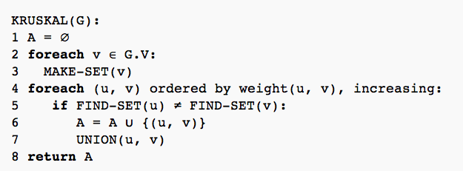
Kruskal's Algorithm
Each node is a set by itself
Get the smallest edge at each time
If the two nodes are in different sets (trees), then this edge will not form a cycle
Add this edge and union the two sets (merge the two trees)

Slide 28
Analysis of Kruskal's Algorithm: Naive
O(V)
Need to sort the edges first O(E Log E)
--Naïve implementation needs O(V) each time
--Will be called E times (at worst) ➔ O(EV)
Naïve implementation ➔ O(V) + O(E Log E) + O(E V) ➔ O(E V)

Slide 29
Analysis of Kruskal's Algorithm: Efficient
O(V)
Put the edges in a minHeap O(E Log E)
** Can be done in linear time O(E)
--Can be done with some tricks in O (Log V)
--Will be called E times (at worst) ➔ O(E LogV)
Naïve implementation ➔ O(V) + O(E Log E) + O(E Log V)
➔ O(E Log E) // Since E < V² , then Log E < 2 Log V
➔ O(E Log V)

Slide 30

Algorithms for Obtaining the Minimum Spanning Tree
Kruskal's Algorithm
Prim's Algorithm
Both of these are Greedy Algorithms

Slide 31
Prim's Algorithm
This algorithm maintains two groups of nodes (Old graph) and (New graph).
The New graph starts with one node. (At then end it will be the MST)
At each step, select a node from the Old graph and add it to the New graph
  Select the node whose connecting edge has the smallest weight to any node in the New graph.
The greedy choice

Slide 32
Complete Graph
B
4
C
4
2
1
A
4
E
1
F
D
2
3
10
G
5
5
6
3
4
I
H
2
3
J

Slide 33
Old Graph
New Graph
-Think of the black edges as cost ∞ (not valid)
-Only the blue ones are valid
B
4
C
4
B
4
C
2
1
4
2
1
A
4
E
1
F
A
4
E
F
1
D
2
3
10
D
2
3
G
5
10
G
5
5
6
3
5
6
3
4
I
4
H
I
3
H
2
J
2
3
J

Slide 34
Old Graph
New Graph
-Think of the black edges as cost ∞ (not valid)
-Only the blue ones are valid
B
4
C
4
B
4
C
2
1
4
2
1
A
4
E
1
F
A
4
E
F
1
D
2
3
10
D
2
3
G
5
10
G
5
5
6
3
5
6
3
4
I
4
H
I
3
H
2
J
2
3
J

Slide 35
Old Graph
New Graph
-Think of the black edges as cost ∞ (not valid)
-Only the blue ones are valid
B
4
C
4
B
4
C
2
1
4
2
1
A
4
E
1
F
A
4
E
F
1
D
2
3
10
D
2
3
G
5
10
G
5
5
6
3
5
6
3
4
I
4
H
I
3
H
2
J
2
3
J

Slide 36
Old Graph
New Graph
-Think of the black edges as cost ∞ (not valid)
-Only the blue ones are valid
B
4
C
4
B
4
C
2
1
4
2
1
A
4
E
1
F
A
4
E
F
1
D
2
3
10
D
2
3
G
5
10
G
5
5
6
3
5
6
3
4
I
4
H
I
3
H
2
J
2
3
J

Slide 37
Old Graph
New Graph
-Think of the black edges as cost ∞ (not valid)
-Only the blue ones are valid
B
4
C
4
B
4
C
2
1
4
2
1
A
4
E
1
F
A
4
E
F
1
D
2
3
10
D
2
3
G
5
10
G
5
5
6
3
5
6
3
4
I
4
H
I
3
H
2
J
2
3
J

Slide 38
Old Graph
New Graph
-Think of the black edges as cost ∞ (not valid)
-Only the blue ones are valid
B
4
C
4
B
4
C
2
1
4
2
1
A
4
E
1
F
A
4
E
F
1
D
2
3
10
D
2
3
G
5
10
G
5
5
6
3
5
6
3
4
I
4
H
I
3
H
2
J
2
3
J

Slide 39
Old Graph
New Graph
-Think of the black edges as cost ∞ (not valid)
-Only the blue ones are valid
B
4
C
4
B
4
C
2
1
4
2
1
A
4
E
1
F
A
4
E
F
1
D
2
3
10
D
2
3
G
5
10
G
5
5
6
3
5
6
3
4
I
4
H
I
3
H
2
J
2
3
J

Slide 40
Old Graph
New Graph
-Think of the black edges as cost ∞ (not valid)
-Only the blue ones are valid
B
4
C
4
B
4
C
2
1
4
2
1
A
4
E
1
F
A
4
E
F
1
D
2
3
10
D
2
3
G
5
10
G
5
5
6
3
5
6
3
4
I
4
H
I
3
H
2
J
2
3
J

Slide 41
Old Graph
New Graph
-Think of the black edges as cost ∞ (not valid)
-Only the blue ones are valid
B
4
C
4
B
4
C
2
1
4
2
1
A
4
E
1
F
A
4
E
F
1
D
2
3
10
D
2
3
G
5
10
G
5
5
6
3
5
6
3
4
I
4
H
I
3
H
2
J
2
3
J

Slide 42
Old Graph
New Graph
-Think of the black edges as cost ∞ (not valid)
-Only the blue ones are valid
B
4
C
4
B
4
C
2
1
4
2
1
A
4
E
1
F
A
4
E
F
1
D
2
3
10
D
2
3
G
5
10
G
5
5
6
3
5
6
3
4
I
4
H
I
3
H
2
J
2
3
J

Slide 43
Complete Graph
Minimum Spanning Tree
Sum of the weights is the smallest = 22
B
4
C
4
B
4
C
2
1
4
2
1
A
4
E
1
F
A
E
F
1
D
2
3
10
D
2
G
5
G
5
6
3
3
4
I
H
I
3
H
2
J
2
3
J
It is possible that Kruskal and Prim algorithms generate different trees but the cost will be the same.

Slide 44
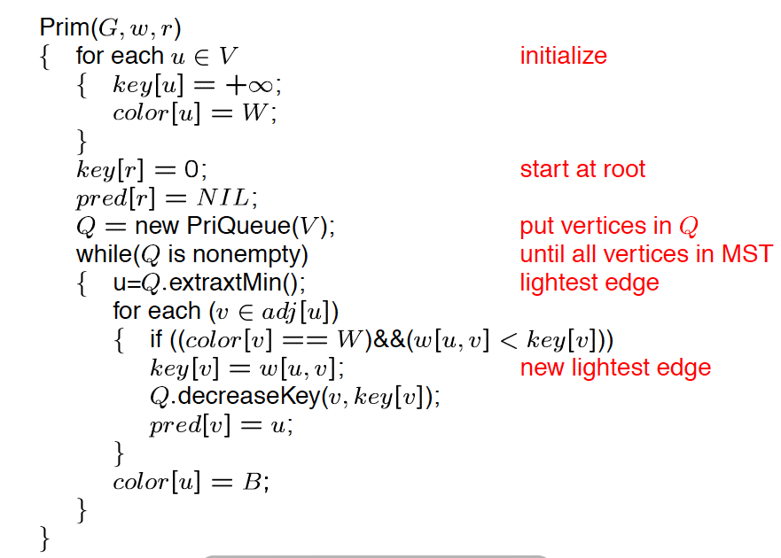

Prim's Algorithm: Pseudocode
For all nodes, make the cost of each one ∞ and White (not selected yet)
Select a root (make its cost 0)
Select a root (make its cost 0)
Select the smallest from Q (the node to add to the New graph)
Update the cost of all adjacent nodes to u

Slide 45
Prim's Algorithm: Analysis
O(V)
O(V Log V)
The loop repeats V times
Total of V calls: O(V Log V)
The loop repeats overall E times (for the V calls)
Total of E times: O(E Log V)

Slide 46
Prim's Algorithm: Analysis
O(V)
Total: O(V) + O(V Log V) + O(V Log V) + O(E Log V) ➔ O( E Log V)
O(V Log V)
The loop repeats V times
Total of V calls: O(V Log V)
The loop repeats overall E times (for the V calls)
Total of E times: O(E Log V)

Slide 47
Algorithms for Obtaining the Minimum Spanning Tree
Kruskal's Algorithm
Prim's Algorithm
Both of these are Greedy Algorithms

